Slide 1
Reduced Order Modeling for CFD:
Will Working in 3D eventually be Cheaper than Working in 2D?
YES….

Slide 2
Means for Design and Compliance
Computational, Experimental, Flight Fluid Mechanics: CFD, EFD, FFD
CFD
1 day 5,000€
EFD
1 week
250,000€
FFD
1 month
$1,000,000€

Slide 3
Reduced Order Modeling: the approach
1. Sampling of the design space (DoE)
$$\left\{x_{1},x_{2},…,x_{N_{S}}\right\}$$
2. Obtain an set of snapshots of the system
$$\left\{U_{1},U_{2},…,U_{N_{S}}\right\}$$
3. Extract the “most energetic” modes from the ensemble (POD)
$$φ_{j},j=1,…,N_{S}$$
“Provide a low-DoF approximation to the solution while retaining the same physics (RANS) and same dimensionality (3D)
Dramatic reduction in CPU time, from hours or days, to seconds
Off-line
4. Compute the solution of the system at “untried” conditions (Kriging)
$$U\left(x^{δ}\right)=\sum_{j=1}^{M≤N_{S}}{α_{j}^{δ}φ_{j}}$$
On-line
Notes:
$x­_{i}∈ℝ^{N_{D}}$ specifies input parameters defining observation conditions, e.g. Mach, AoA for flow simulations; MVD, LWC for icing simulations. $N_{D}$ is the number of design variables.
$U_{i}=U\left(x_{i}\right)∈ℝ^{N_{P}}$ are the snapshots defined with the input parameter $x_{i}$. $N_{P}$ is the number of data point contained in a snapshot.
For CFD solutions, $N_{P}$ equals number of mesh nodes, for experimental data, $N_{P}$ equals number of probes.
$U$ can be pressure field, shear stress field, ice shape represented by the x, y, z coordinates, etc.

Slide 4
ROM: The Successive Steps
DoE
Snapshots
POD
POD
Offline
Kriging
Online

Slide 5
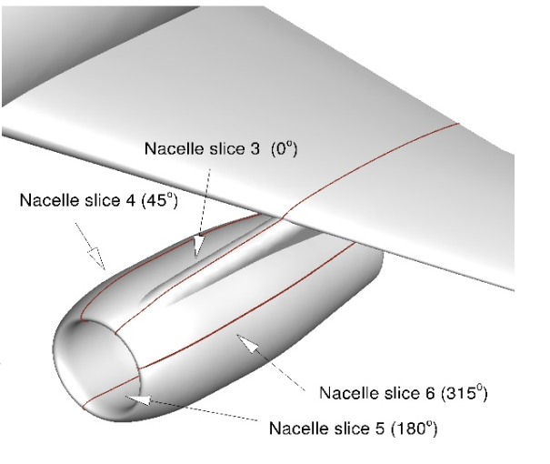
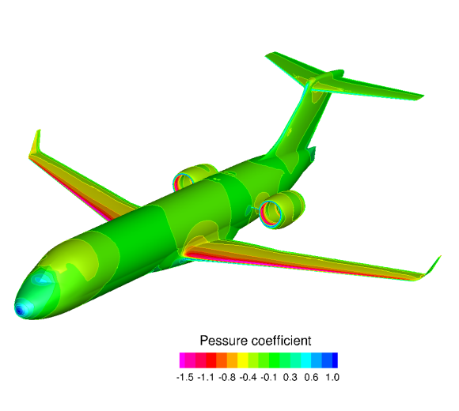
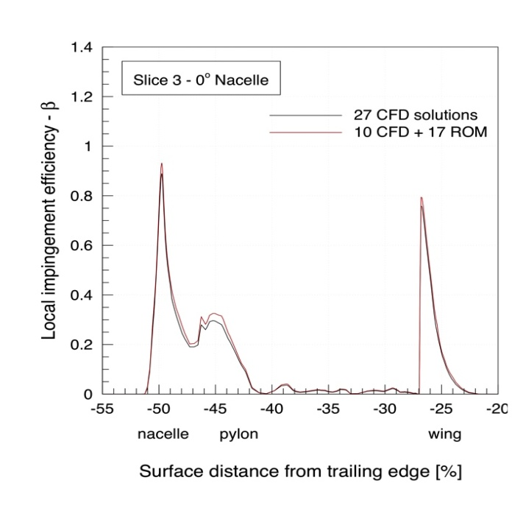
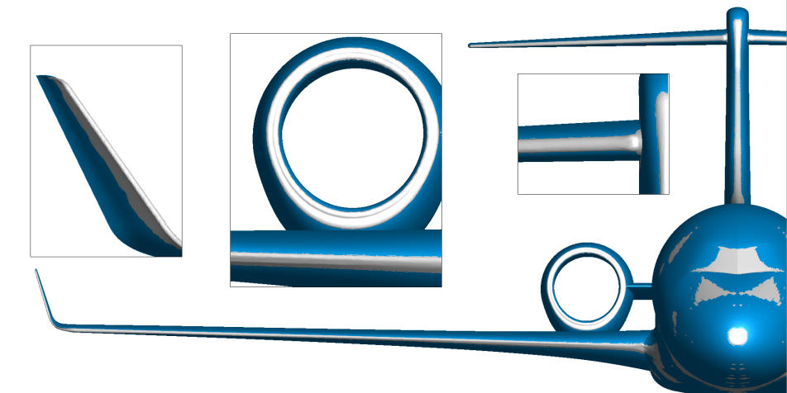
Calculating the snapshots
DROP
Snapshots can be
  Numerical results
    Airflow solution
    Droplet solution
    Ice accretion solution
FLOW
ICE
Notes:
The snapshots can be numerical results, experimental data, or even a combination of both, as long as they are dimensionally homogeneous, i.e. the same number of data points contained in each snapshot

Slide 6
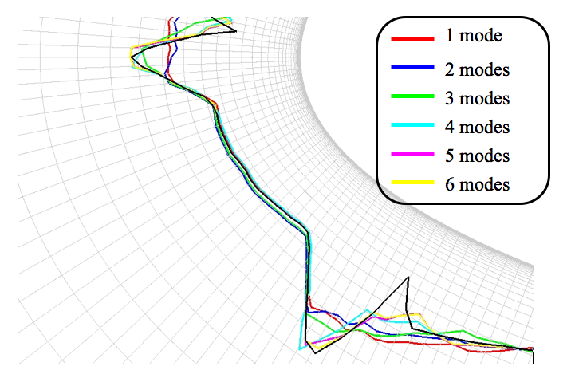
The physics of the problem are captured by the modes!
Modes 1 and 2
Mode 3
Mode 4
Modes 5, 6, etc.
do not add much
Ice thickness !
Upper horn !
Lower horn !

Slide 7
It Costs 5,000$ Per Hour to Run on 50,000 cores
That means 0.1$
per hour
per core

Slide 8
How Many $ to Run 56 Snapshots?
Assuming 1 full day (24 hours) and 256 cores to run,
for a complete aircraft:
flow, impingement, accretion and performance degradation,
the cost of a ROM snapshot is less than 700$
Running 56 snapshots costs about 40,000$
That is less than the cost of one day in an icing tunnel !
and then you have a complete 3D icing simulator at your desk
At that point, 3D becomes cheaper than 2D!

Slide 9
How Many Days to Run 56 Snapshots?
If each snapshot takes a full day?
And the answer is,
Still 1 Day!
50,000 cores / 256 cores = can easily run up to 195 snapshots simultaneously on same computer

Slide 10
ROM applied to impingement

Slide 11
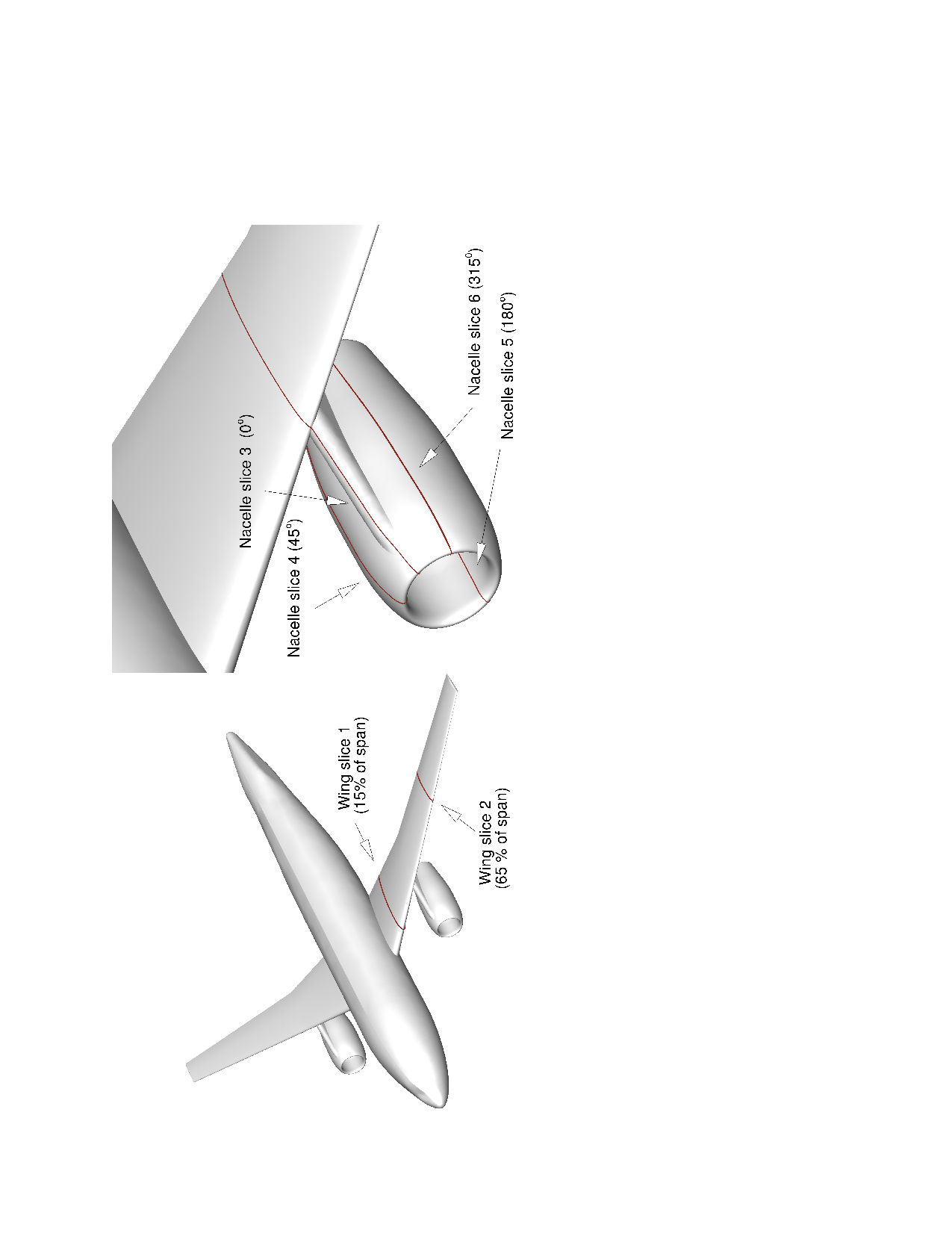
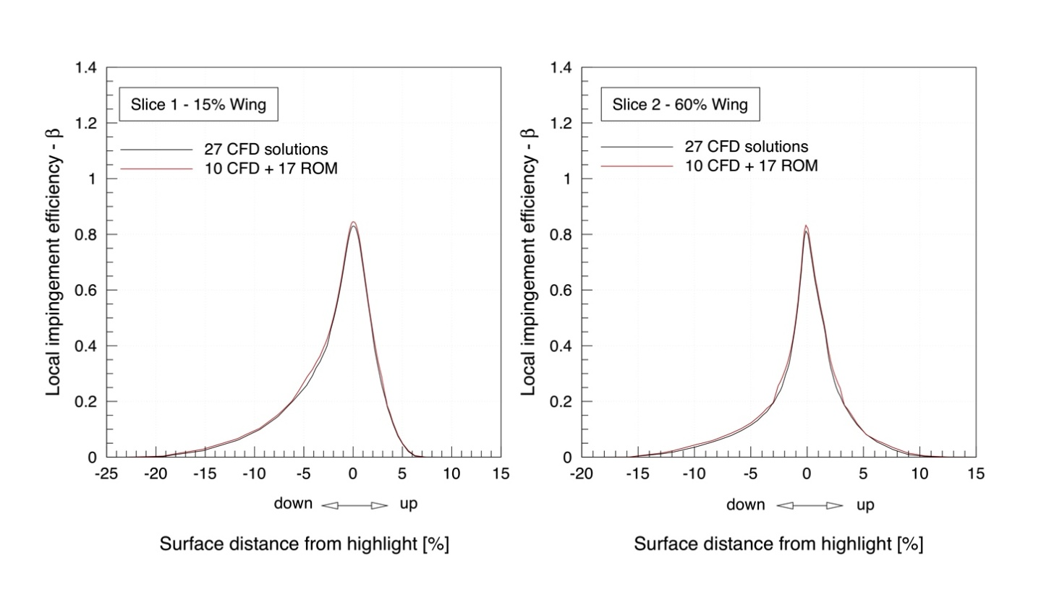
ROM vs. full CFD: comparison of β
Comparison of collection efficiency at wing sections for CFD and ROM
60 seconds on 1 CPU
vs.
68 hours on 64 CPUs

Slide 12
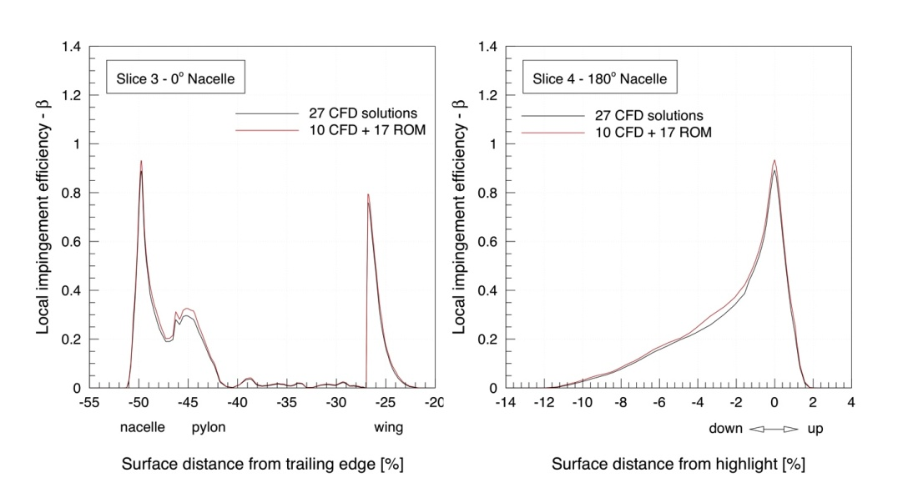
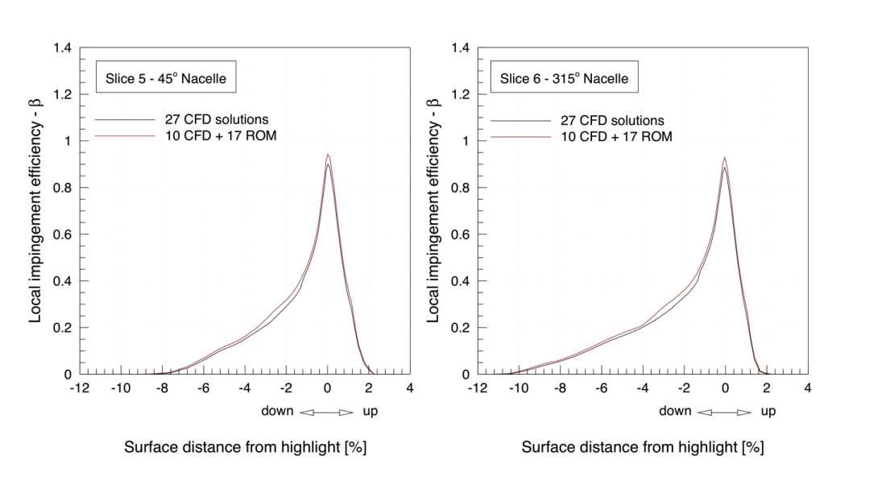
ROM vs. full CFD: comparison of β
Comparison of collection efficiency at pylon-nacelle for CFD and ROM

Slide 13
ROM applied to ice accretion

Slide 14
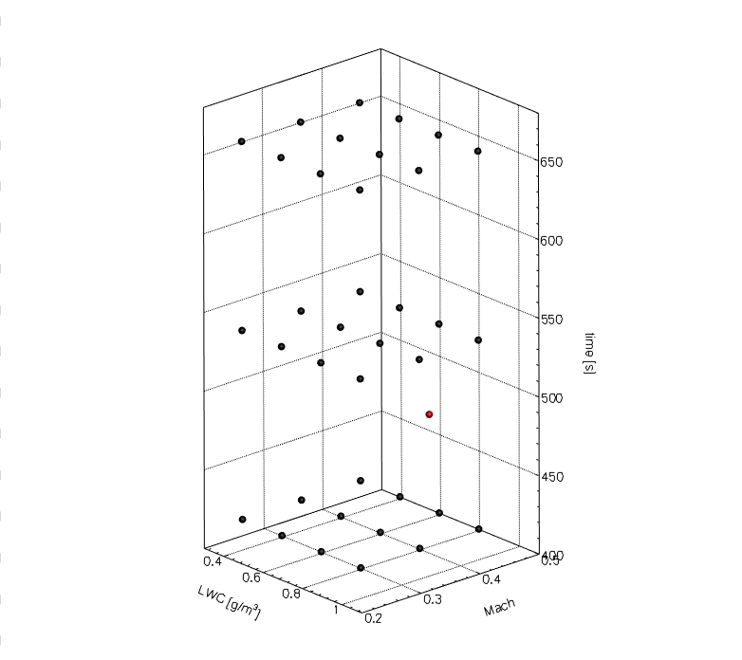
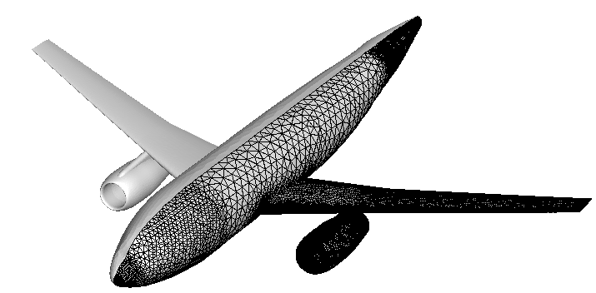
Aero-icing for DLR-F6 via ROM
Parameters: Mach, LWC (g/m³), time (s)
Data: Surface mesh after ice accretion
36 Snapshots have been used
AoA= 5º T=263 K MVD = 20 μm
Mesh 2,281,111 nodes, 1,875,932 tetra and 3,823,680 prisms (left).
Snapshots arrangement and target (red point) position (right)
Notes:
Using POD/Kriging and 36 snapshots the ice shape can be accurately approximated (again just to stress that this specific ice shape does not come from snapshots, it is at uncalculated point). Minor traces can be seen. But the thickness of ice is insignificant.

Slide 15
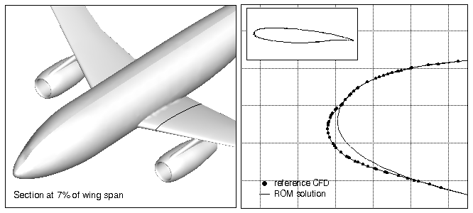
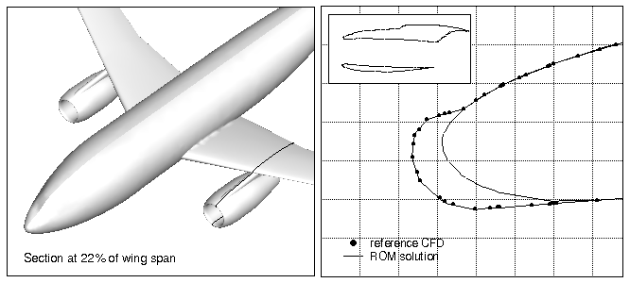
DLR-F6 – 3D Aero-icing, ice profile at selected cuts

Slide 16
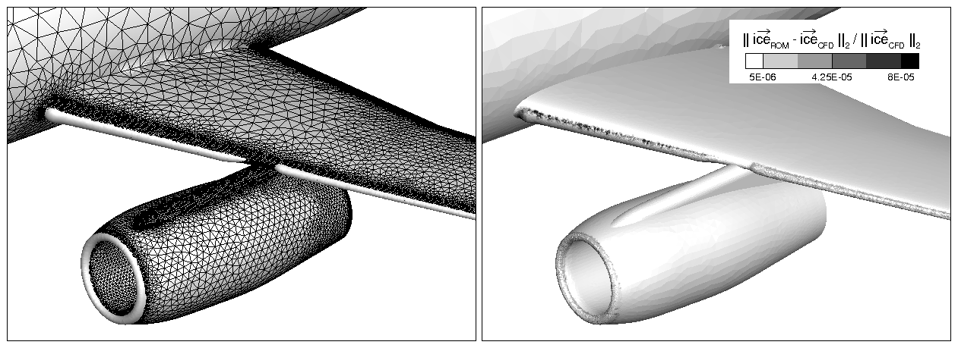
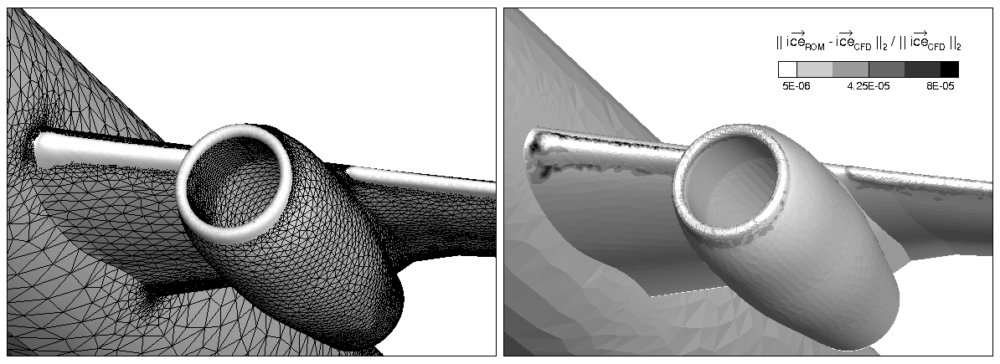
DLR-F6: ROM vs CFD
CFD
9 hours on 64 CPU (left)
ROM
25 s on 1 CPU (right)
Notes:
Using POD/Kriging and 36 snapshots the ice shape can be accurately approximated (again just to stress that this specific ice shape does not come from snapshots, it is at uncalculated point). Minor traces can be seen. But the thickness of ice is insignificant.

Slide 17
ROM applied to experimental measurements

Slide 18
ROM with experimental data
ROM can be used as an aid to experimental campaigns where the measured data are used as snapshots
An experimental campaign in the IRT facility used 5 parameters: velocity, total temperature, LWC, MVD and spray time
to get 15 snapshots (upper figures)
The interested output is ice thickness at
locations E and F in the parameter space (right picture)

Slide 19
ROM with experimental data, verification at target points
Rime ice
Ice thickness (left), experimental ice shape (right)
Glaze ice

Slide 20
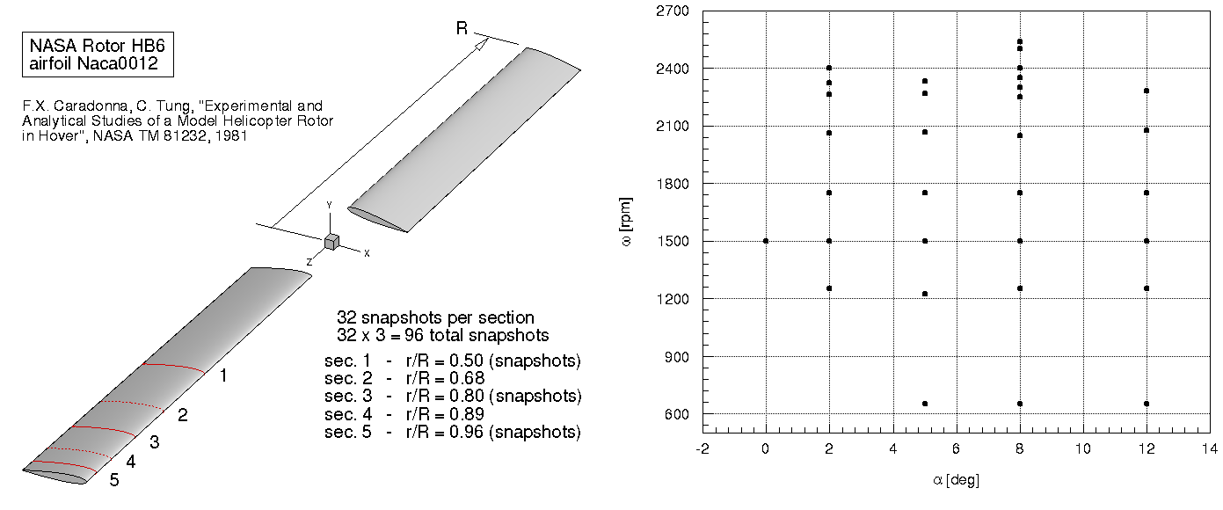
RBM with Experiments: Caradonna-Tung Test Case
RBM can be used in the context of experimental campaigns to reduce:
the complexity of the model
the number of tests to perform in the wind tunnel
Parameters of the analysis:
Pitch [degs]: 0 - 12
Rotational speed [rpm]: 650 – 2540
32 cond. x 5 sec. = 160 snapshots
Two-bladed rotor
NACA0012 airfoil
5 sections instrumented
Snapshots arrangement

Slide 21
Reduction of Model Complexity
Model simplification: Reduction of model instrumentation to 3 sections instead of 5.
96 acquisitions instead of 160
Two targets have been chosen for validation:
B
A
 | r/R | ω [rpm] | α [deg]
Target A | 0.68, 0.89 | 1250 | 8
Target B | 0.68, 0.89 | 2268 | 5
Model simplification. Targets arrangement

Slide 22
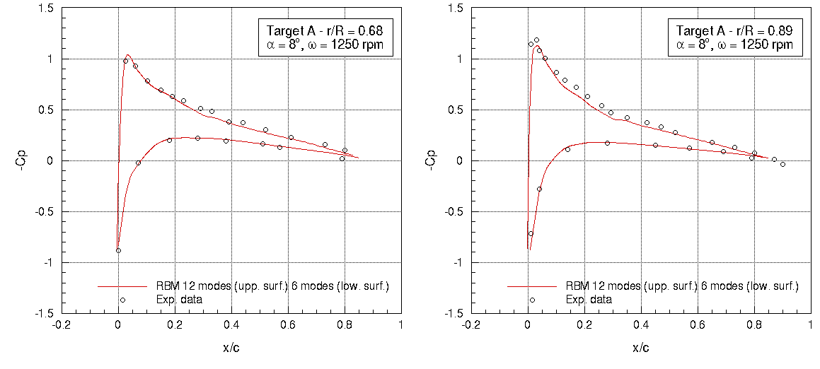
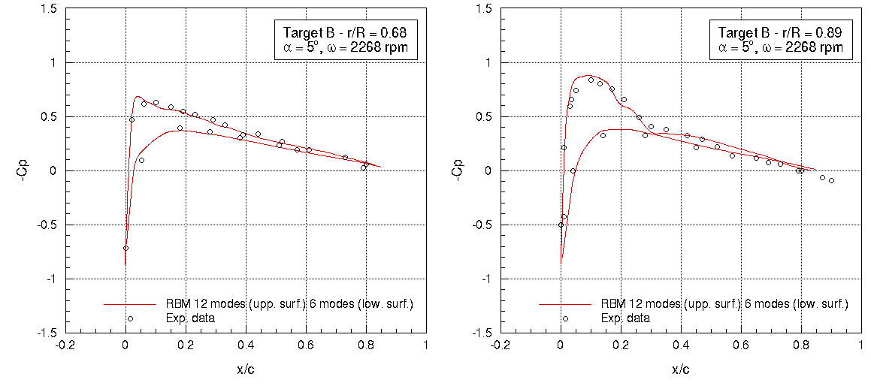
Model Simplification: Validation

Slide 23
Model Simplification and Reduction of Tests
Reduction of tunnel tests: 3 sections and avoid all runs with Pitch = 8 deg
63 acquisitions instead of 160
Two targets are chosen for validation:
D
C
 | r/R | ω [rpm] | α [deg]
Target C | 0.68, 0.89 | 1250 | 8
Target D | 0.68, 0.89 | 2400 | 8
Reduction of tunnel tests
Targets arrangement

Slide 24
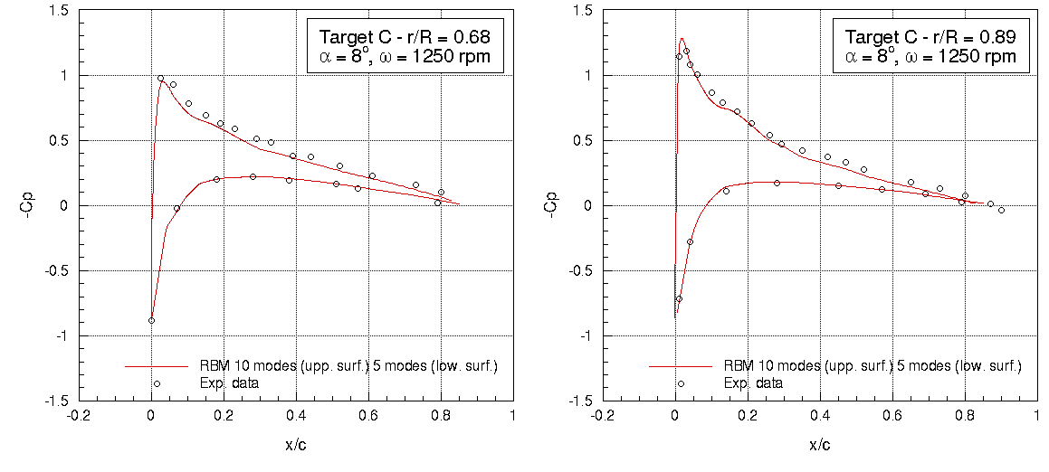
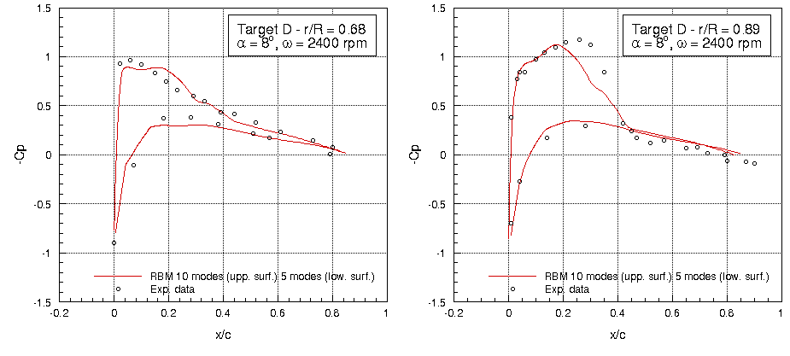
Reduction of Model Complexity and Tunnel Tests: Validation

Slide 25
ROM applied to CG calculation

Slide 26
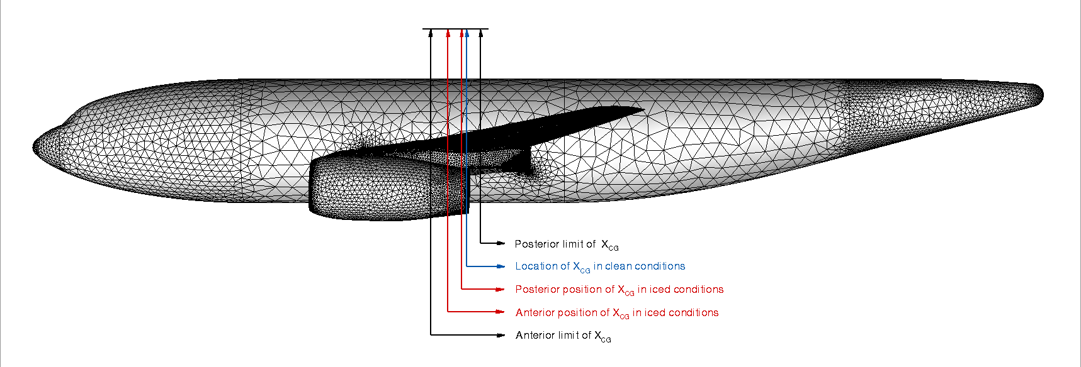
DLR-F6 – Change of CG, parametric analysis
Snapshots &
300 targets (left)
Weight increase (right)
CG variation (bottom)

Slide 27
ROM applied to entire Appendix C for ice accretion and for aerodynamic performance
2D example

Slide 28
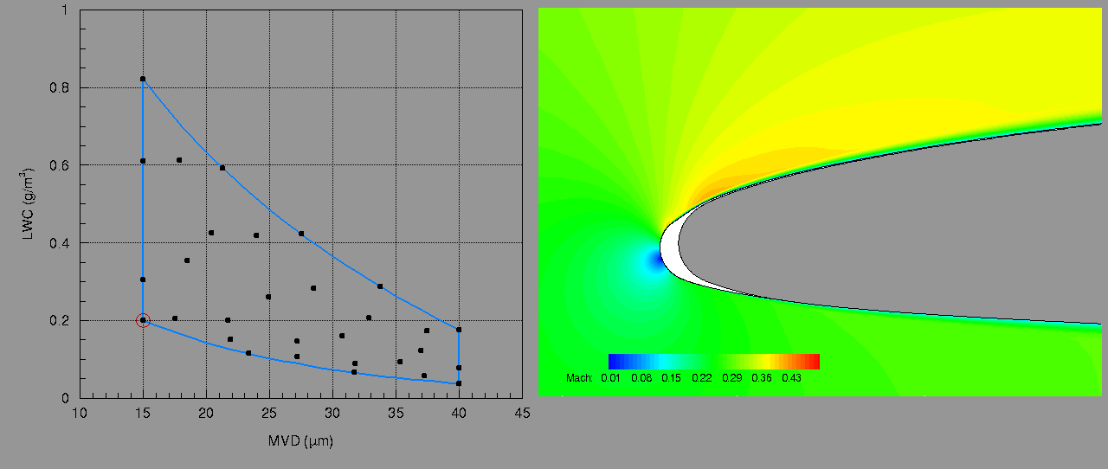
ROM: Appendix C “Complete” Investigation of 2D Ice Shapes
Parameters: LWC(g/m³), MVD (μm)
Desired output: Mass of ice
GLC305 airfoil
30 snapshots selected via Centroidal Voronoi Tessellation
Angle of attack = 2.5 deg, Mach = 0.3
Altitude = 11000 ft., Time of accretion = 7 min.

Slide 29
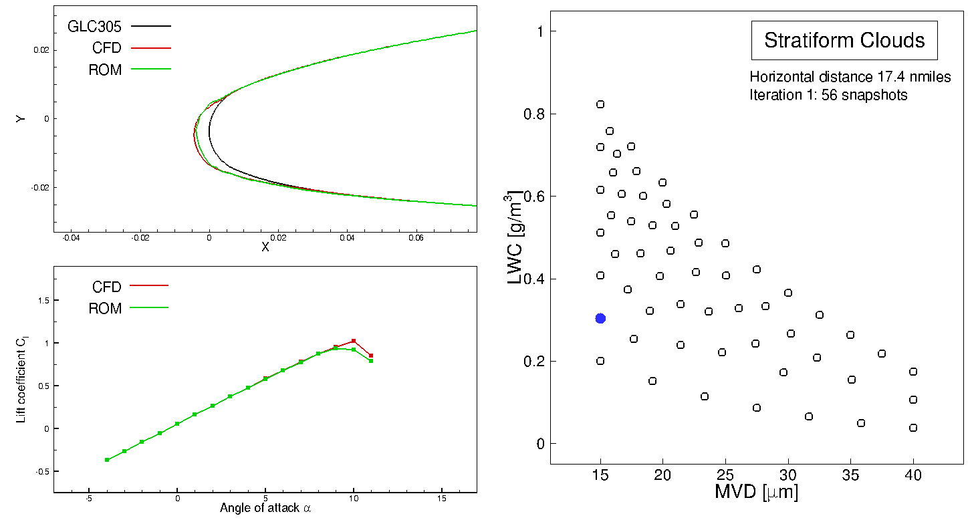
Exploration of App C for an airfoil
Notes:
Two types of snapshots are considered: shape of ice and the associated & Cl-alpha curves
Leave-one-out of the first sampling iteration, with 56 snapshots

Slide 30
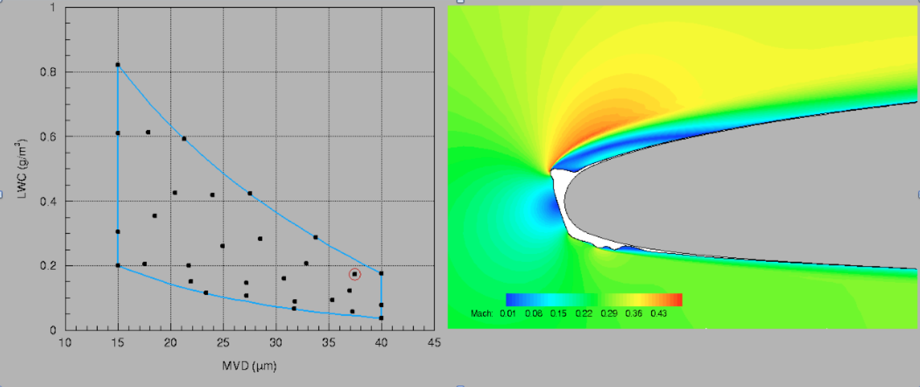
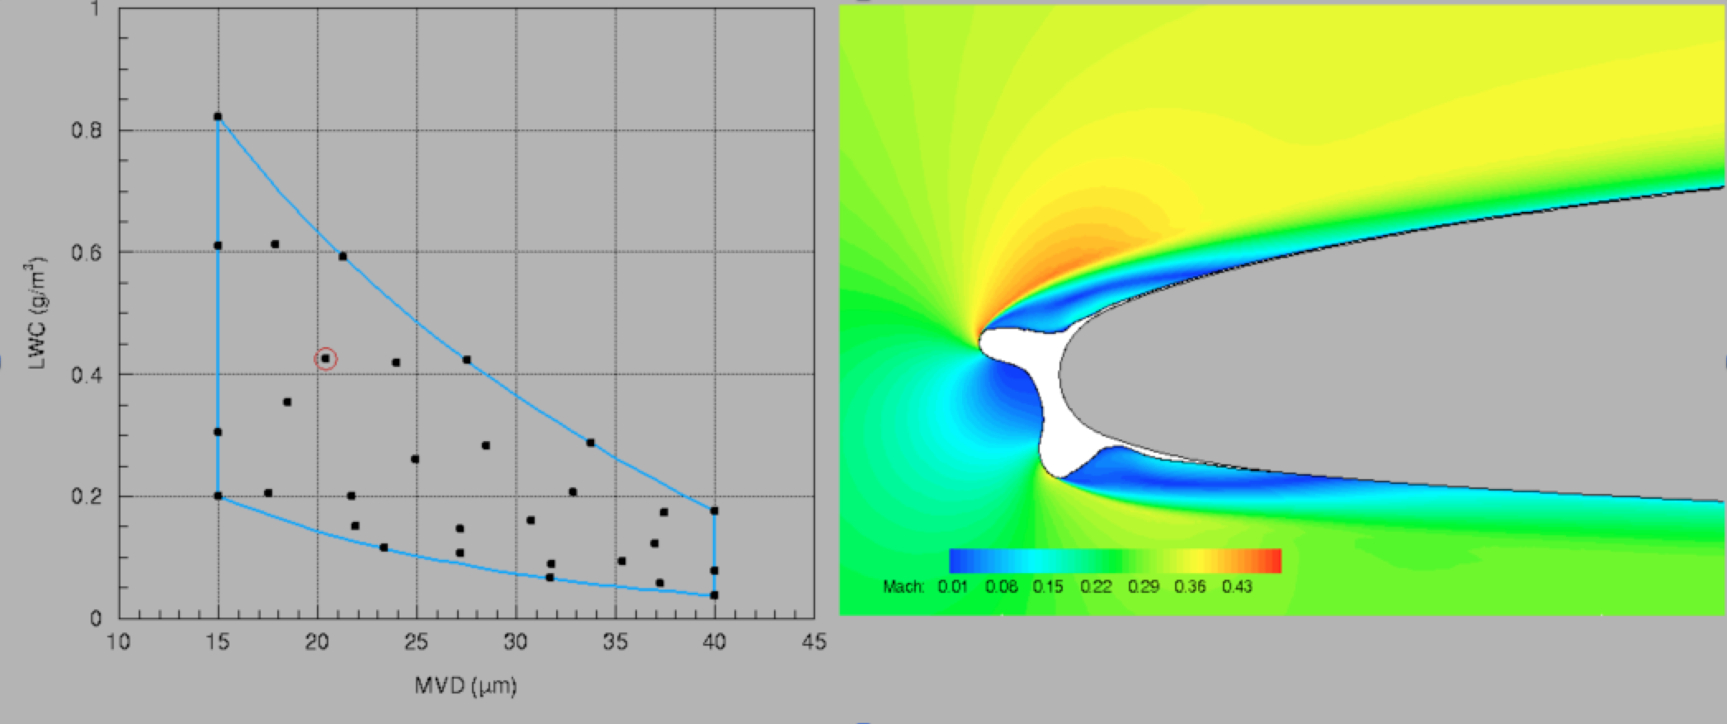
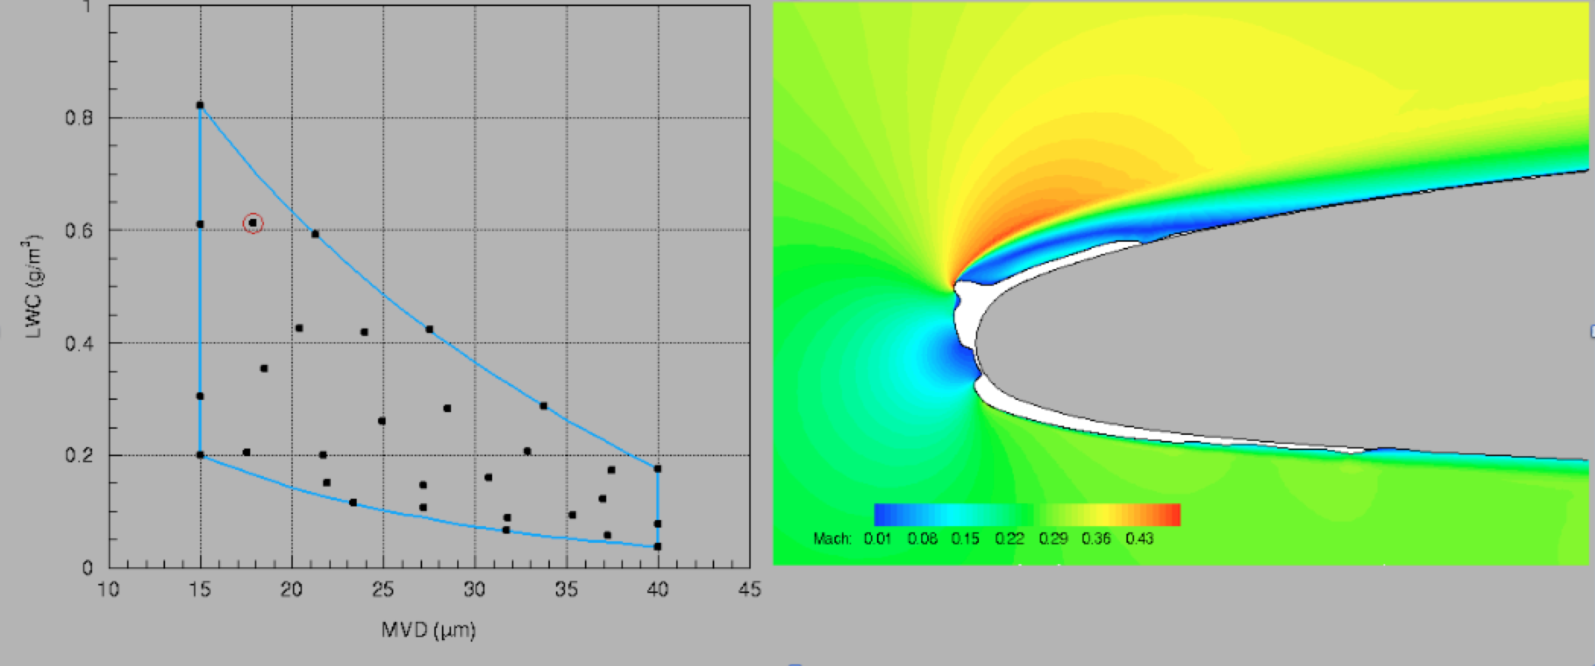
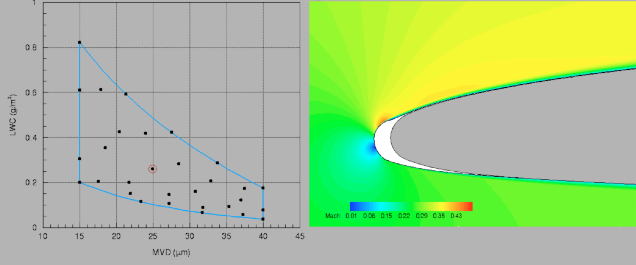
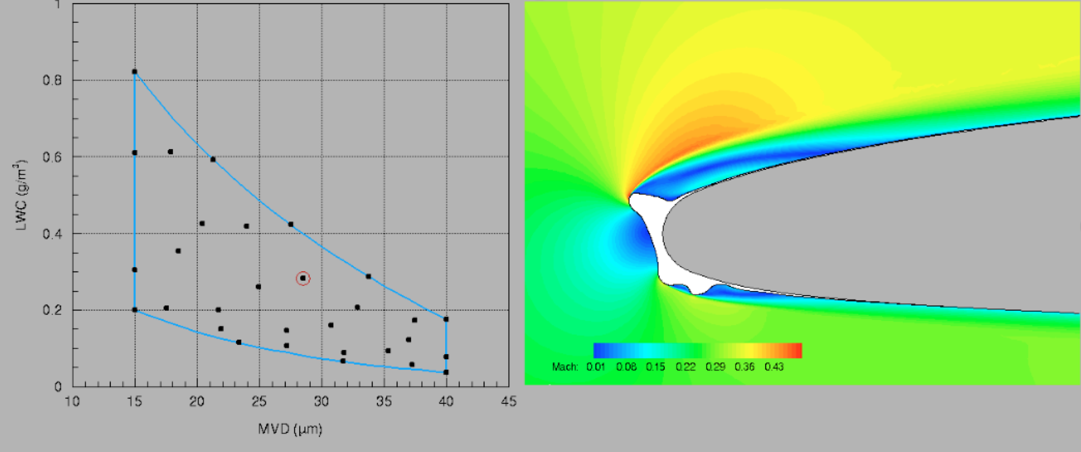
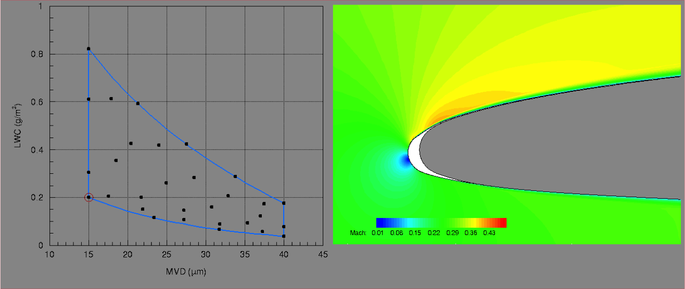
ROM: Appendix C “Complete” Investigation Ice Shapes

Slide 31
ROM applied to entire Appendix C for natural icing campaign
3D complete aircraft example

Slide 32

Ice accretion after 25 min hold in stratiform clouds
MVD = 18.01 µm LWC = 0.40 g/m³ Temperature = 8.37 ̊ F

Slide 33
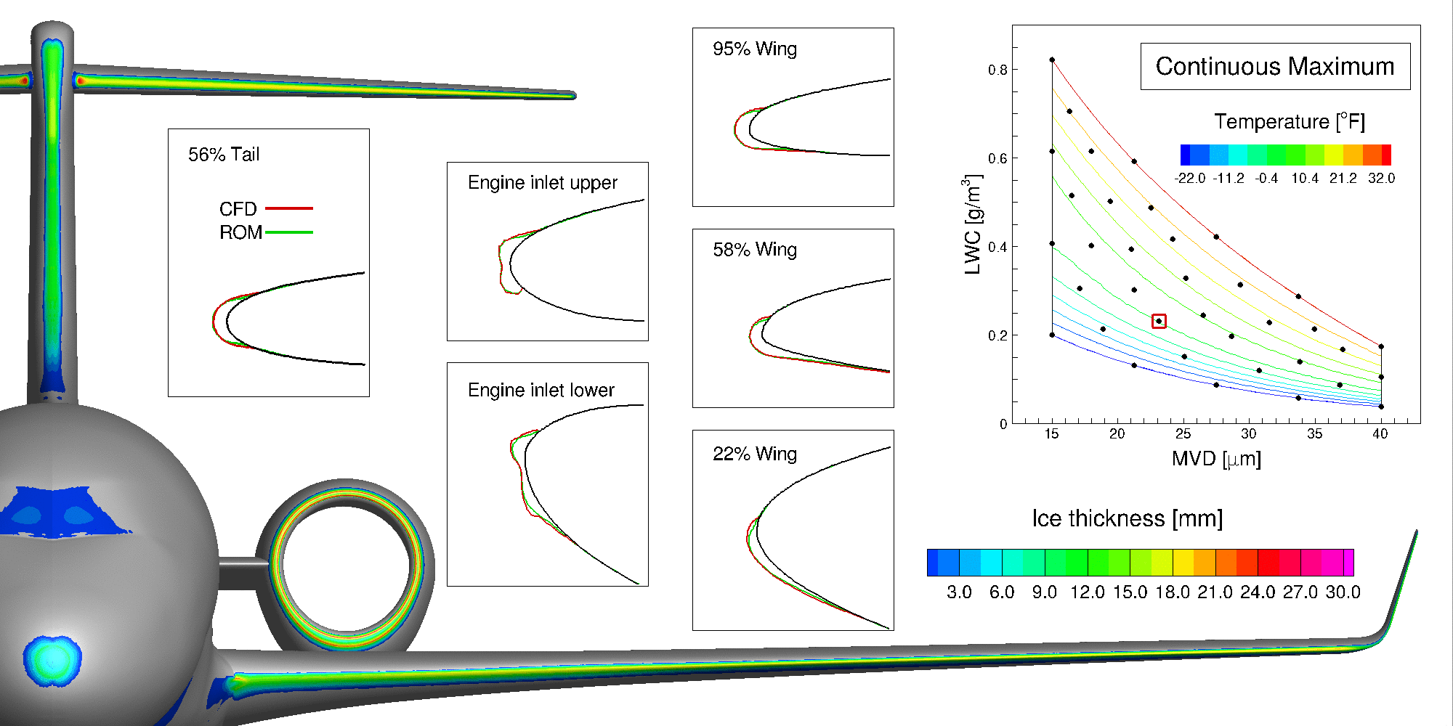

LOOCV of the Initial Sampling
Altitude: 16,404 ft Speed: 268 KTAS AoA: 3.7° Exposure time: 25 minutes
Notes:
Emphasize tat it is the first time that icing is calculated in 3D over the entre airplane, not just components

Slide 34
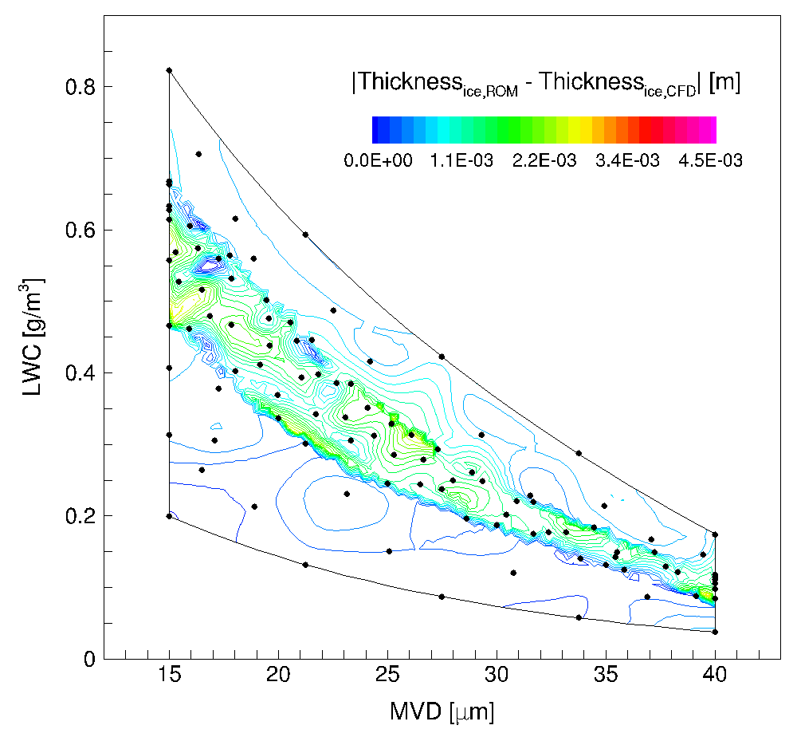
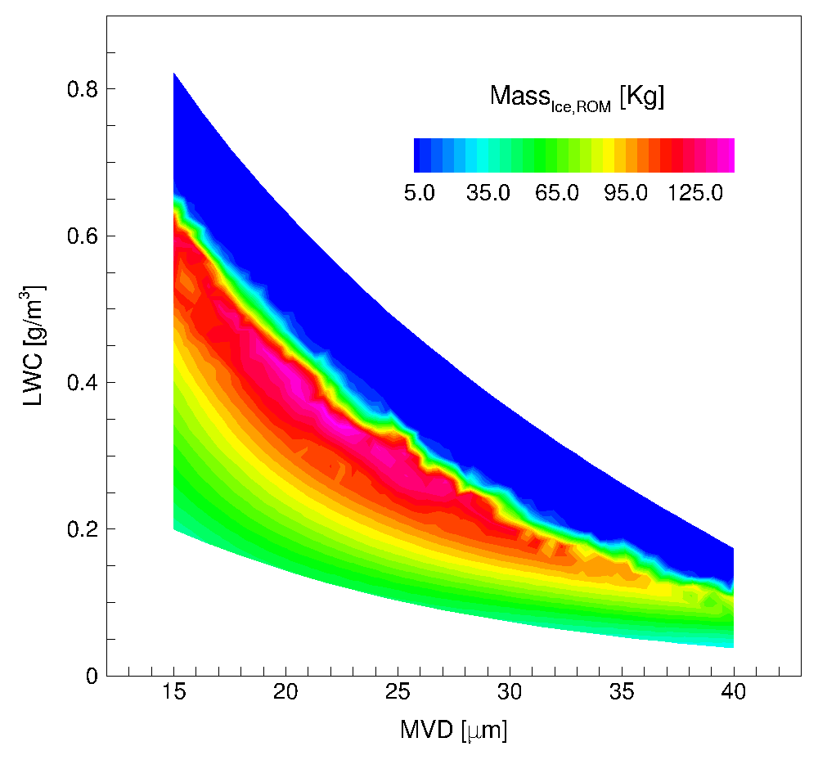
Complete exploration of CM
LOOCV error -- ice thickness
103 snapshots
Mass of ice -- 25 min hold
1000 ROM solutions
Each CFD-ICE: 16-32 h on 128 CPUs
Each ROM: 2 s on 16 CPUs
Notes:
At the end of the iterative sampling, 103 snapshots are obtained, partitioned into 3 clusters, for a final state of three local reduced-order bases.
Figure (left) shows the ice thickness error distribution for the last iteration. The maximum error has been reduced to 2.7 mm (which accounts for 9% of $δ_{ice,CFD,max}$), a 40% deduction of the maximum error obtained from the initial sampling, whereas for the majority of the icing envelope, the error is less than 1.2 mm.

Slide 35
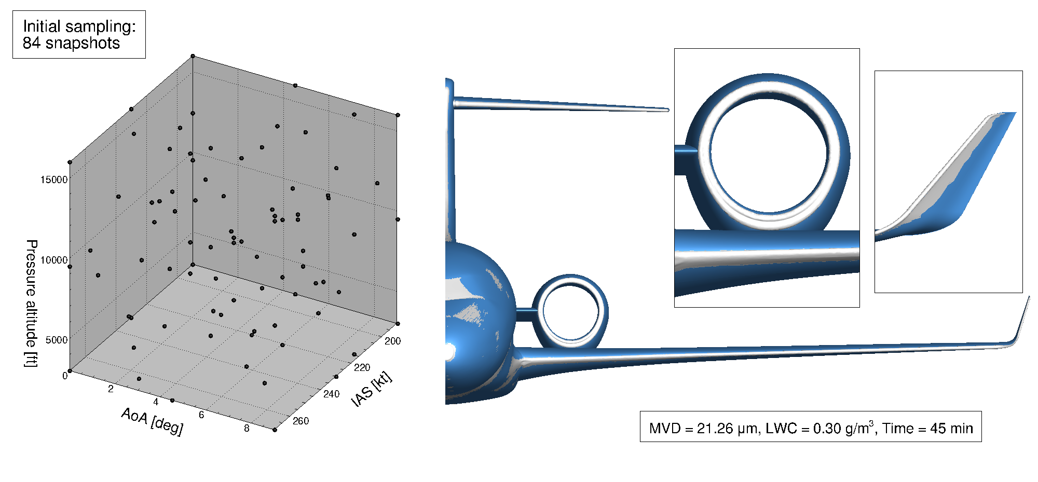
Initial sampling and shape of ice used for aerodynamic degradation analysis
Notes:
The ice shape considered is obtained by FENSAP-ICE from a 45-minute (1 shot) exposure under a CM icing condition (MVD = 21.26 μm, LWC = 0.30 g/m³), at typical holding flight conditions (5,000 meters pressure altitude, 268 knots true air speed and 3.675° AoA), with clean aircraft configuration (flaps/slats retracted, no deflection of control surfaces).
For the aerodynamic analysis in question, the snapshots $U_{i}$ are the flow variables of interest: pressure at the 9,788,214 nodes of the volume mesh and shear stress at the 202,260 surface nodes.

Slide 36
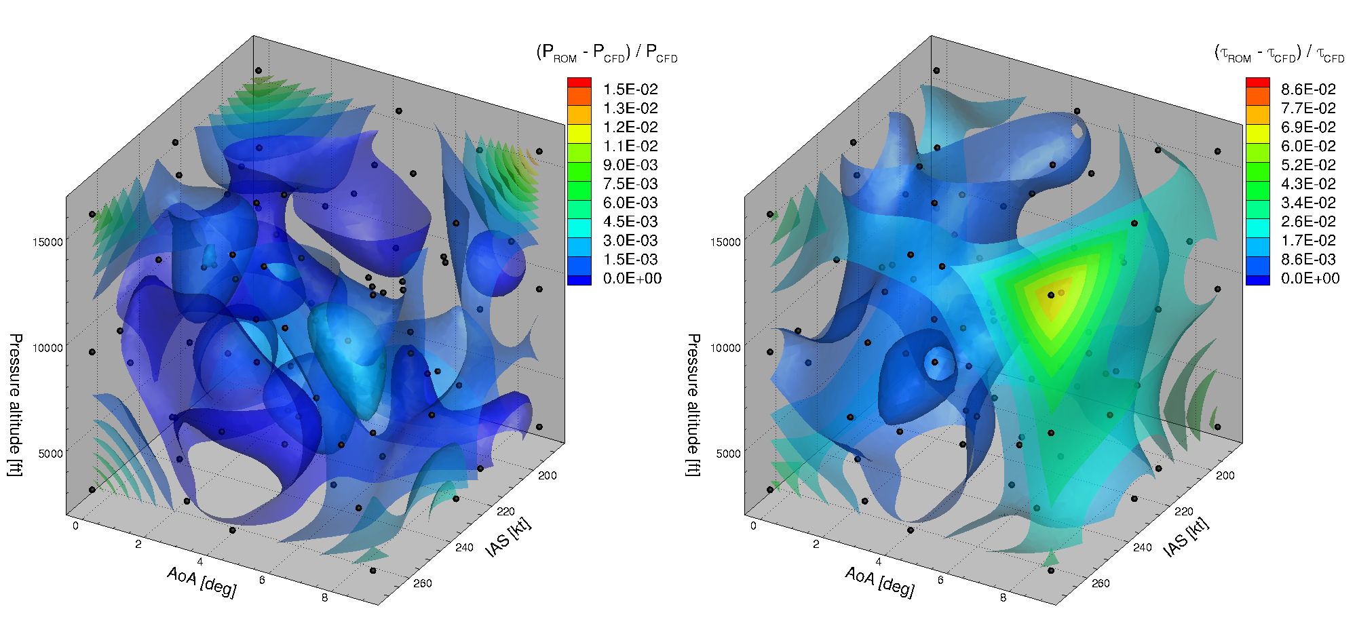
LOOCV error of the initial sampling, iced geometry
84 snapshots
Max error 1.5%
Avg. error 0.17%
Max error 8.6%
Avg. error 1.7%
Notes:
volume weighted L2 norm error

Slide 37
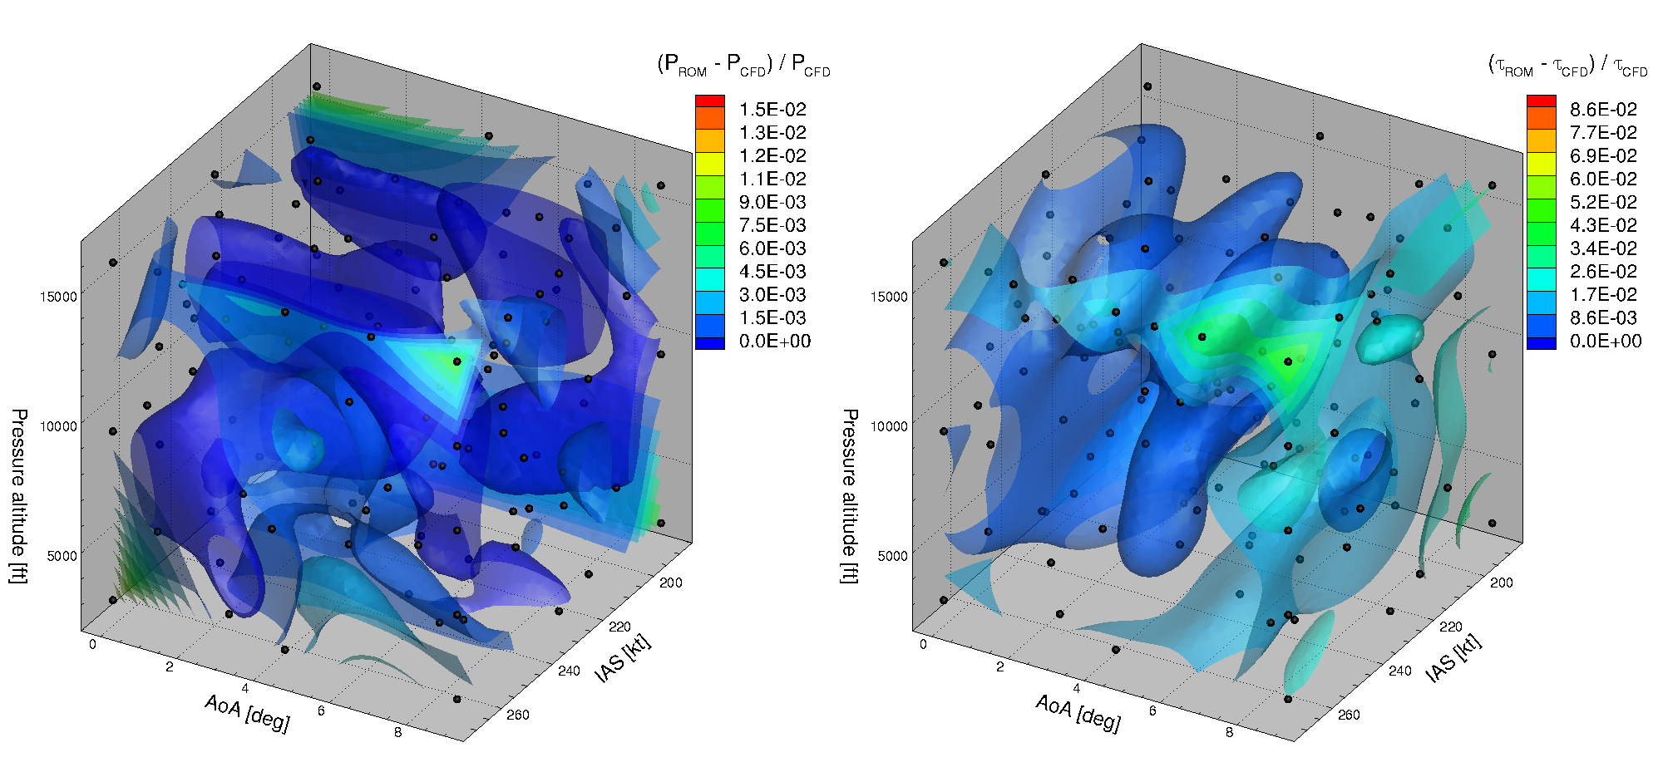
LOOCV error of the final sampling, iced geometry
129 snapshots
Max error 1.3%
Avg. error 0.13%
Max error 6.0%
Avg. error 1.5%
Notes:
After seven sampling iterations, 129 snapshots were defined, with LOOCV error reduced to 1.3% and 6.0%, for pressure and shear stress, respectively

Slide 38
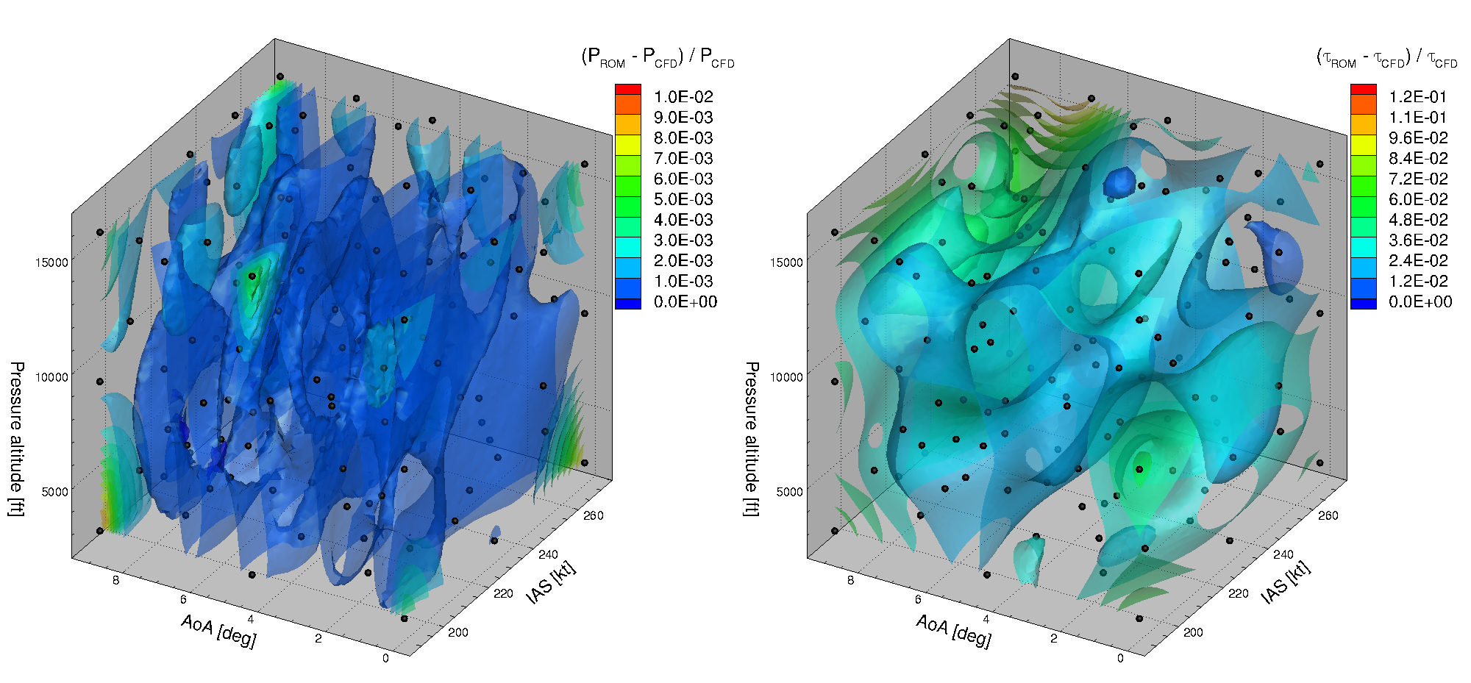
LOOCV error of the final sampling, clean geometry
129 snapshots
Max error 1.0%
Avg. error 0.14%
Max error 11.9%
Avg. error 3.5%
Notes:
In order to assess the aerodynamic performance degradation, flow solutions over the clean geometry are needed and 129 such snapshots under the same flight conditions as the ice-contaminated aircraft have been computed.

Slide 39
ROM applied to a go-around scenario

Slide 40
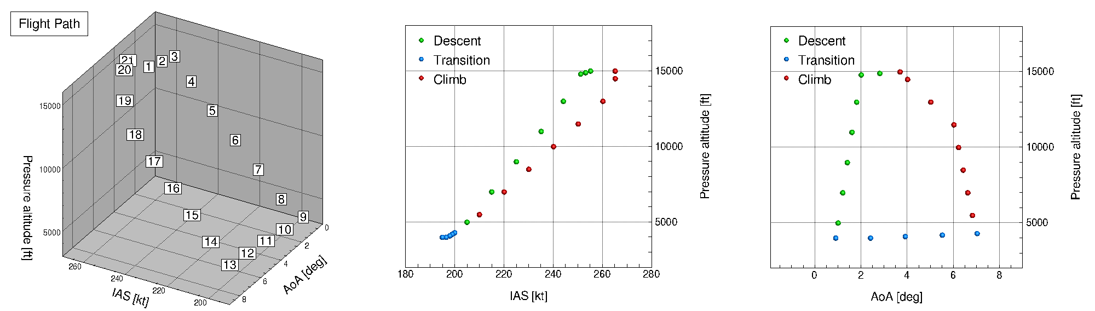

Flight path simulating an aborted landing
Each CFD:
21 h on 128 CPUs
Each ROM:
28 s on 16 CPUs
Notes:
A hypothetical flight path representing an aborted descent is simulated using 21 target points, as shown in the top left figure.
Targets 1 to 9 represent the process that the airplane is allowed to exit holding pattern and descend to 3,000 feet; targets 9 to 13 demonstrate the abortion of the descend, where the AoA increases from 0.9° to 7.0°, and the airplane starts to regain altitude; targets 13 to 21 illustrate the climb stage, for which the aircraft gets back to the holding altitude and resume level flight AoA, after which it may need to prepare for a second landing, or fly to an alternate airport.
The ROM contains 4 solution fields, i.e. pressure and the x, y, z shear stress. The computation of each ROM takes 28 s using 16 CPUs, however, 87% of time is consumed in data reading, due to the limit of network band width. The actual computational time was only 3.6 s.

Slide 41
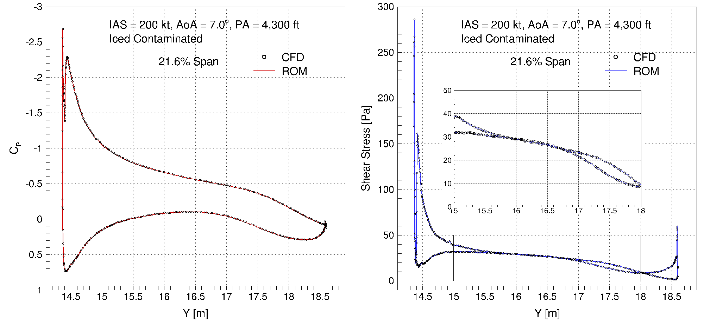
ROM vs. CFD, iced geometry, target 13
Notes:
Wing root

Slide 42
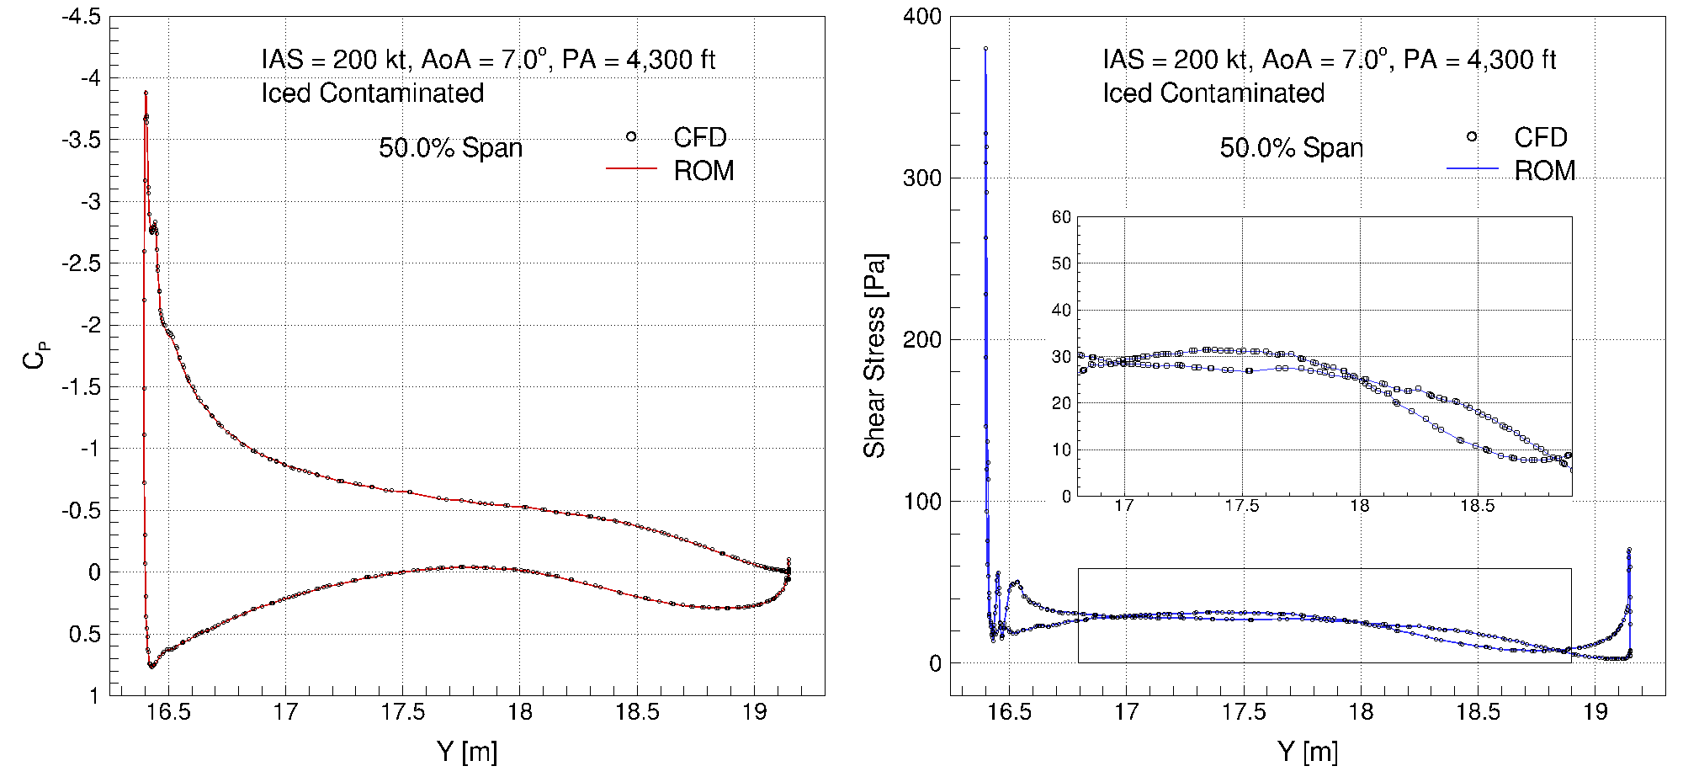
ROM vs. CFD, iced geometry, target 13
Notes:
Wing mid

Slide 43
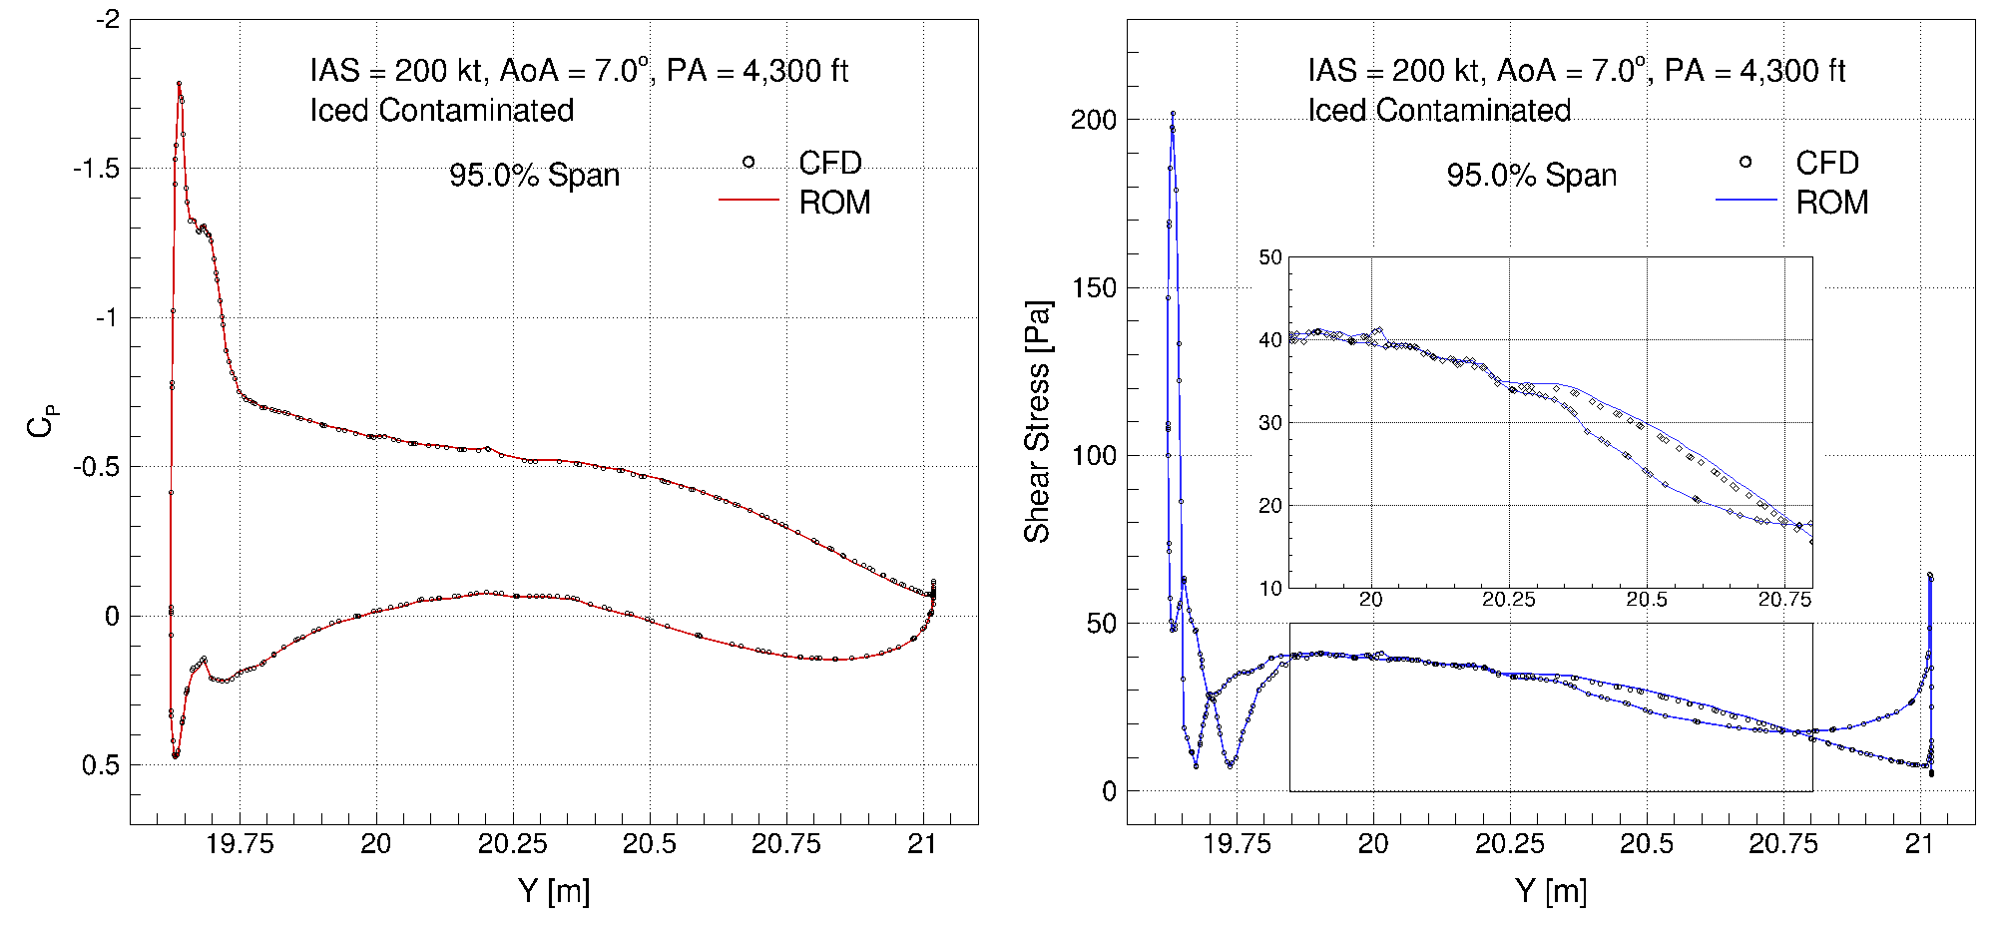
ROM vs. CFD, iced geometry, target 13
Notes:
Wing tip

Slide 44
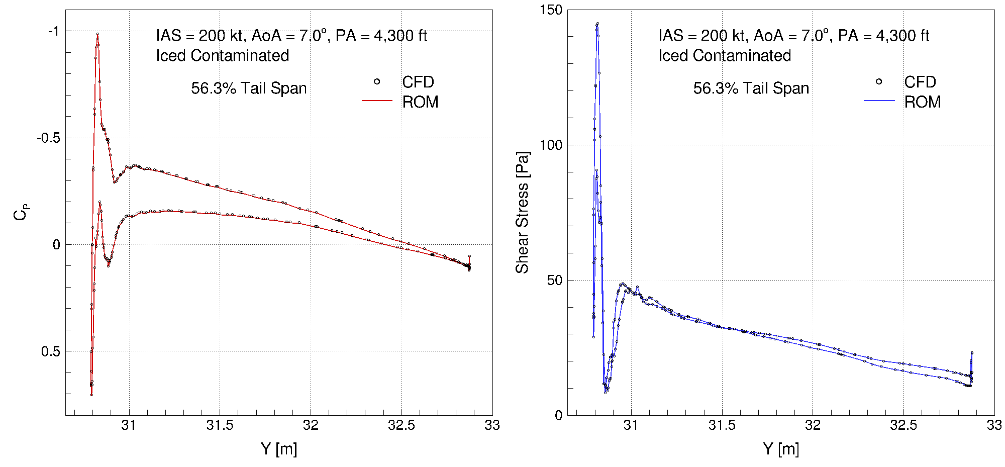
ROM vs. CFD, iced geometry, target 13
Notes:
Tail mid section

Slide 45
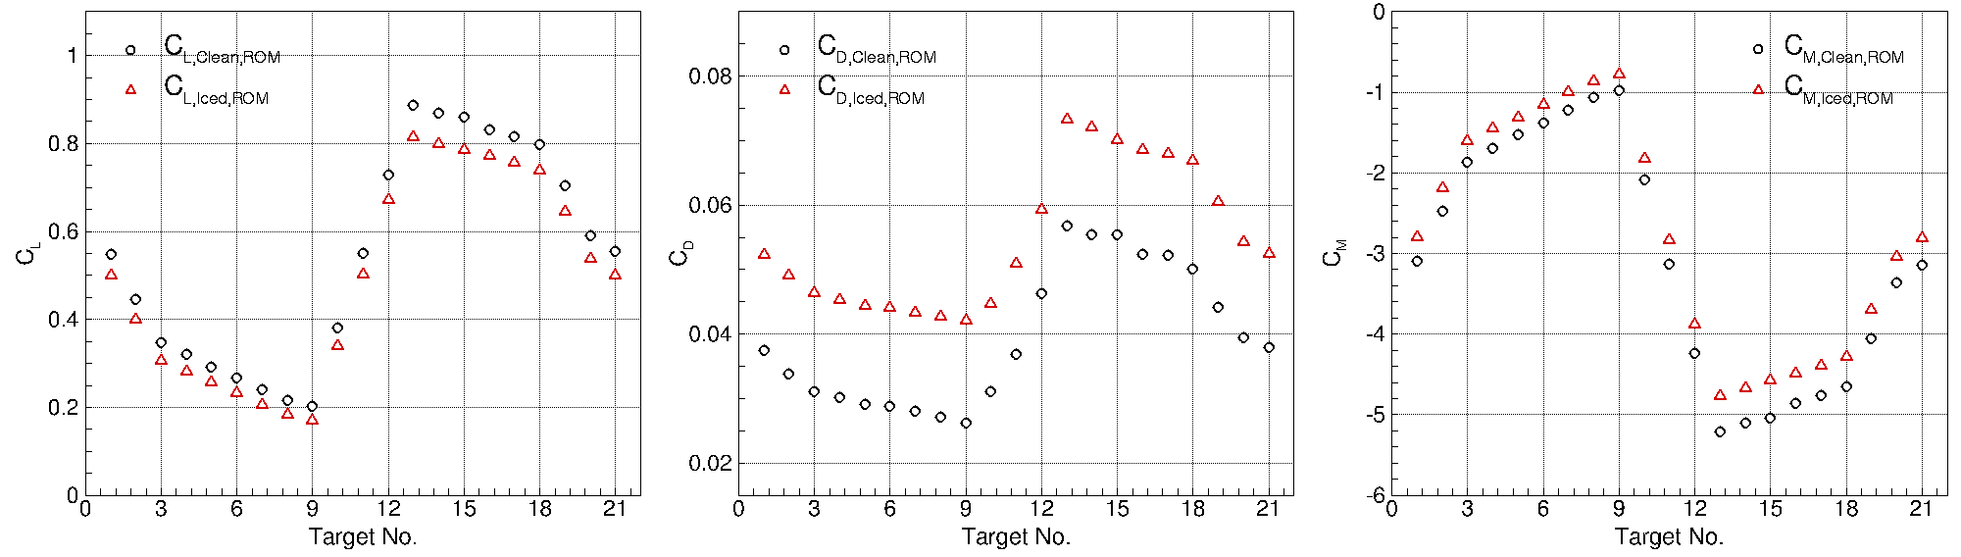
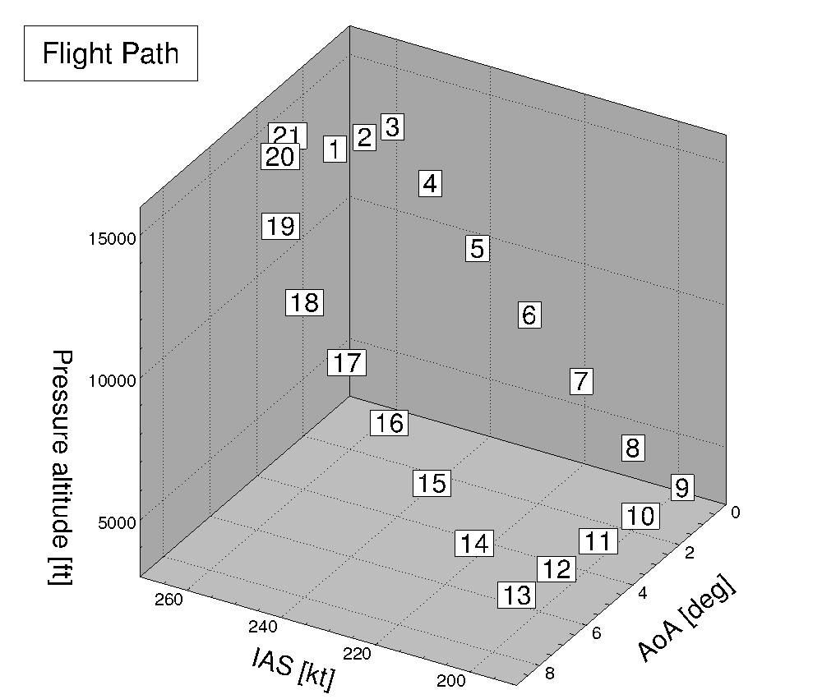
Aerodynamic degradations in $C_{L}$, $C_{D}$ and $C_{M}$
Information developed in this research may be incorporated into a flight simulator.
Improve simulator fidelity and enable pilot training for in-flight icing

Slide 46
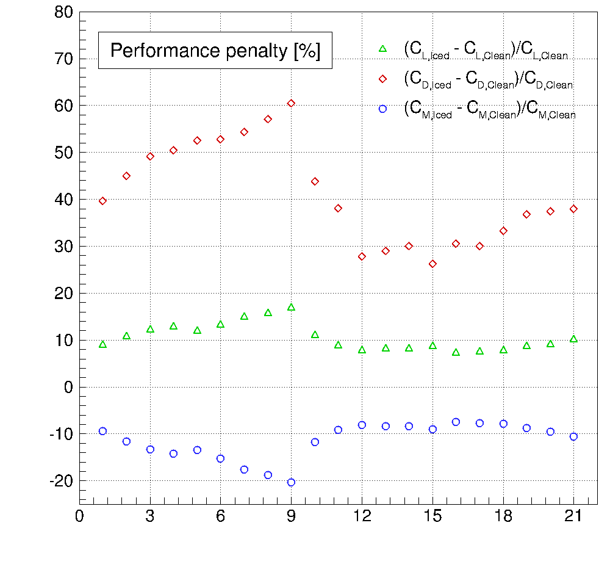
Performance penalty for ice contaminated airplane
17% C_{L} loss
60% C_{D} increase
20% C_{M} change

Slide 47
ROM applied to desk or flight simulators

Slide 48
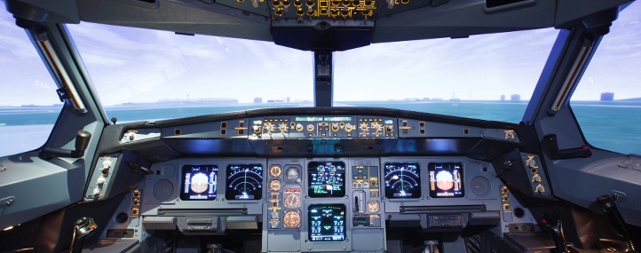
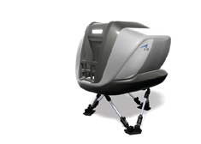
Reduced Order Modeling’s objectives
Reduced Order Modeling (ROM):
  Provide an approach to considerably reduce cost of 3D simulations
  Provide a methodology to couple CFD, EFD and FFD data
  Provide a methodology to obtain information on APP C points not found in nature, giving a more complete picture of the icing and flight envelopes interaction
  Provide real-time representations of in-flight icing for pilot training

